Slide 1
Socially Relevant Projects Using Design Thinking FINAL PROJECT REVIEW HELD ON 21/05/2025 E-WASTE MANAGEMENT AND RECYCLING APP THUPAKULA NAGALAKSHMI (Reg. No.241FD01147 ) Department of Computer Applications Vignan's Foundation for Science, Technology & Research Supervisor Dr. K.Gayatri, Assistant professor, Dept. of CA, Vignan's Foundation for Science, Technology & Research
Notes:
Logo should be changed/deleted
Date : 10.1
Title ???

Slide 2
Contents
Introduction
Problem Statement
Objectives
Proposed Solution
System Architecture
Tools & Technologies
Output Screens
Challenges & Risks
References

Slide 3
Introduction
Overview of the topic
Electronic waste (e-waste) refers to discarded electrical and electronic devices, including smartphones, laptops, televisions, and other appliances. With rapid technological advancements and increased consumer demand for electronic gadgets, e-waste generation has become a global challenge. The E-Waste Management and Recycling App aims to provide a user-friendly platform that facilitates proper disposal, recycling, and awareness about electronic waste. It will connect users with authorized recycling centers, provide pickup services, and promote sustainable practices.
Relevance and importance
1 Environmental Protection – E-waste contains hazardous materials like lead, mercury, and cadmium, which can harm soil, water, and air if not disposed of properly. Recycling and responsible disposal help reduce pollution.
2 Public Health Safety – Improper disposal of e-waste can lead to toxic exposure, causing serious health issues. A structured e-waste management system ensures a safer environment.
3 Resource Conservation – Electronic devices contain valuable materials like gold, silver, and copper, which can be recovered and reused, reducing the need for raw material extraction.

Slide 4
4 Legal and Social Responsibility – Many governments and organizations emphasize responsible e-waste disposal through regulations and awareness programs. Encouraging individuals and businesses to comply with these laws can make a significant impact.
5 Smart Waste Management – Leveraging technology to streamline e-waste collection, tracking, and processing increases efficiency and accessibility for users.
This project plays a crucial role in promoting sustainable e-waste management practices, reducing environmental hazards, and encouraging responsible recycling behaviors among individuals and businesses.

Slide 5
Problem Statement
What is the problem?
The improper disposal of electronic waste (e-waste) is a growing environmental and health concern. Many individuals and businesses discard old electronic devices irresponsibly, leading to pollution, toxic exposure, and the wastage of valuable materials. There is also a lack of awareness and accessibility to proper recycling methods, making it difficult for people to dispose of e-waste efficiently.
Why is it significant?
Environmental Impact – E-waste contains hazardous materials that can contaminate soil, water, and air if not disposed of properly. Proper recycling reduces pollution and conserves natural resources.
Health Concerns – Toxic substances like lead, mercury, and cadmium from e-waste can cause severe health issues, including respiratory problems and neurological disorders.
Resource Recovery – Electronic devices contain valuable metals that can be recycled and reused, reducing the need for mining and lowering production costs.

Slide 6
4 Regulatory Compliance – Many governments have implemented e-waste management policies, and promoting proper disposal ensures adherence to environmental laws.
5 Lack of Awareness – Many people are unaware of how to dispose of e-waste responsibly, leading to an increasing amount of electronic waste in landfills and illegal dumping sites.
This project addresses these issues by providing a digital platform that facilitates responsible e-waste disposal and recycling, ensuring sustainability and environmental protection. And promotes sustainable e-waste management by enabling responsible disposal, recycling, and awareness. It helps reduce environmental pollution, conserve valuable resources, and protect public health from hazardous e-waste materials. Additionally, it supports legal compliance, encourages corporate social responsibility, and contributes to a circular economy.

Slide 7
Objectives
Clear goals of the project
Develop a User-Friendly E-Waste Management App – Create an intuitive platform that allows users to easily dispose of electronic waste.
Facilitate Proper E-Waste Disposal – Provide users with information on nearby authorized recycling centers and offer pickup services.
Encourage Recycling and Resource Recovery – Promote the recycling of valuable materials like gold, silver, and copper from discarded electronics.
Raise Environmental Awareness – Educate users about the harmful effects of improper e-waste disposal and the benefits of recycling.
Ensure Regulatory Compliance – Align the app with local and international e-waste management laws and policies.
Promote a Circular Economy – Encourage refurbishment and reuse of electronic devices to minimize waste generation.

Slide 8
Objectives
.
7. Introduce Incentives for Users – Implement reward systems to motivate users to dispose of e-waste responsibly.
8. Provide Data Insights on E-Waste Collection – Track e-waste collection and recycling progress to measure environmental impact.
outcomes
Increased E-Waste Recycling Rates – More users will adopt responsible disposal methods, reducing landfill waste.
Reduced Environmental Pollution – Proper recycling and disposal will minimize soil, water, and air contamination.
Greater Public Awareness – More individuals will understand the importance of responsible e-waste management.
Efficient Resource Utilization – Recovery of valuable materials will reduce the need for new raw material extraction.
Compliance with E-Waste Laws – Users and businesses will be more likely to follow legal disposal and recycling regulations.
Enhanced User Engagement – Incentive-based participation will encourage more users to actively recycle their e-waste.

Slide 9
Proposed Solution
How the project aims to solve the problem
Efficient Collection System – Provides users with easy e-waste pickup and drop-off options to improve waste collection.
User Awareness & Education – Offers educational content on responsible e-waste disposal and its environmental impact.
Real-Time Tracking – Allows users to track e-waste disposal and recycling processes through the app.
Partnership with Recyclers – Connects users with authorized recycling centers for safe and legal e-waste processing.
Incentive-Based Recycling – Rewards users with points, discounts, or coupons for properly disposing of e-waste.
AI-Based Sorting Assistance – Uses AI to categorize e-waste and suggest the best disposal or recycling method.
Government Compliance Integration – Ensures adherence to e-waste management regulations and policies.
Eco-Friendly Disposal Solutions – Promotes sustainable methods like urban mining and smart recycling technologies

Slide 10
Brief methodology or approach
Requirement Analysis – Identify user needs, government regulations, and existing e-waste management challenges.
System Design – Develop the architecture, including user interfaces, database structures, and API integrations.
Development Phase – Implement core features like e-waste collection requests, recycler connections, and reward systems.
AI-Based Sorting & Classification – Integrate AI to analyze and categorize e-waste for proper disposal or recycling.
Testing & Validation – Conduct usability, performance, and security tests to ensure a smooth user experience.
Deployment & Integration – Launch the app on multiple platforms and integrate it with authorized recycling centers.
User Feedback & Improvements – Gather user input, analyze performance, and update the app for better efficiency.
Sustainability & Compliance – Ensure adherence to environmental policies and optimize eco-friendly practices.

Slide 11
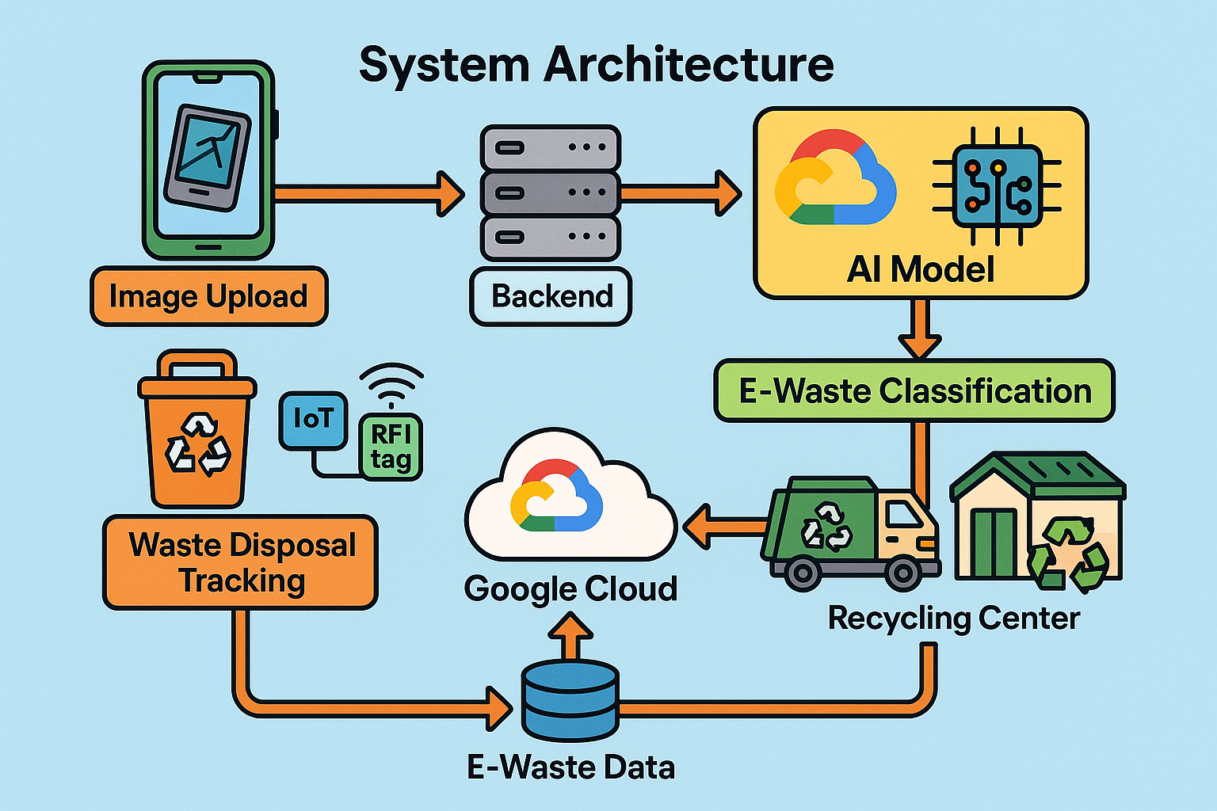
System Architecture:

Slide 12
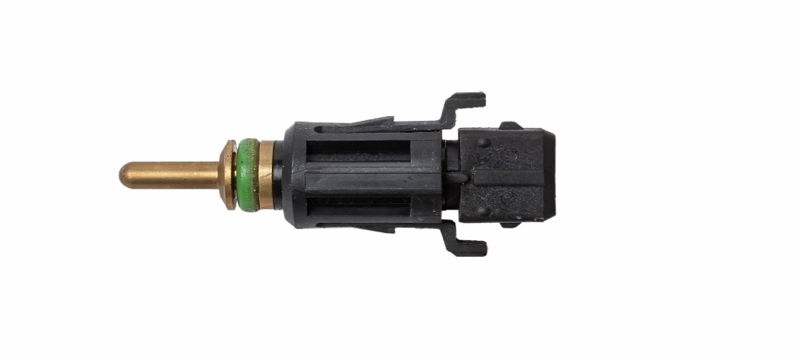

Sensors can use:
Gas Sensors : Gas sensors detect harmful or toxic gases released from e-waste materials, helping to monitor air quality and ensure safety during recycling.
Bad Coolant Temperature Sensor:A coolant temperature sensor measures the temperature inside recycling machinery or electronic devices to prevent overheating and maintain safe operating conditions.

Slide 13
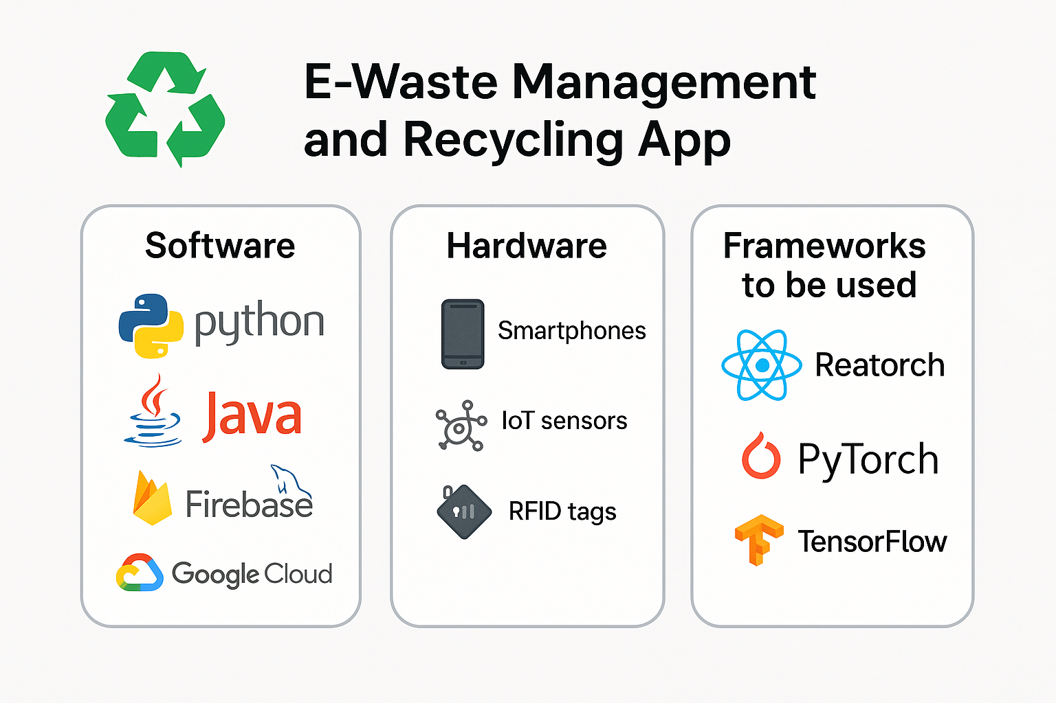
Tools & Technologies
Software
Python, Java, MySQL, Firebase, Google Cloud
Hardware
Smartphones, IoT sensors, RFID tags
Frameworks to be used
React Native, PyTorch, TensorFlow

Slide 14
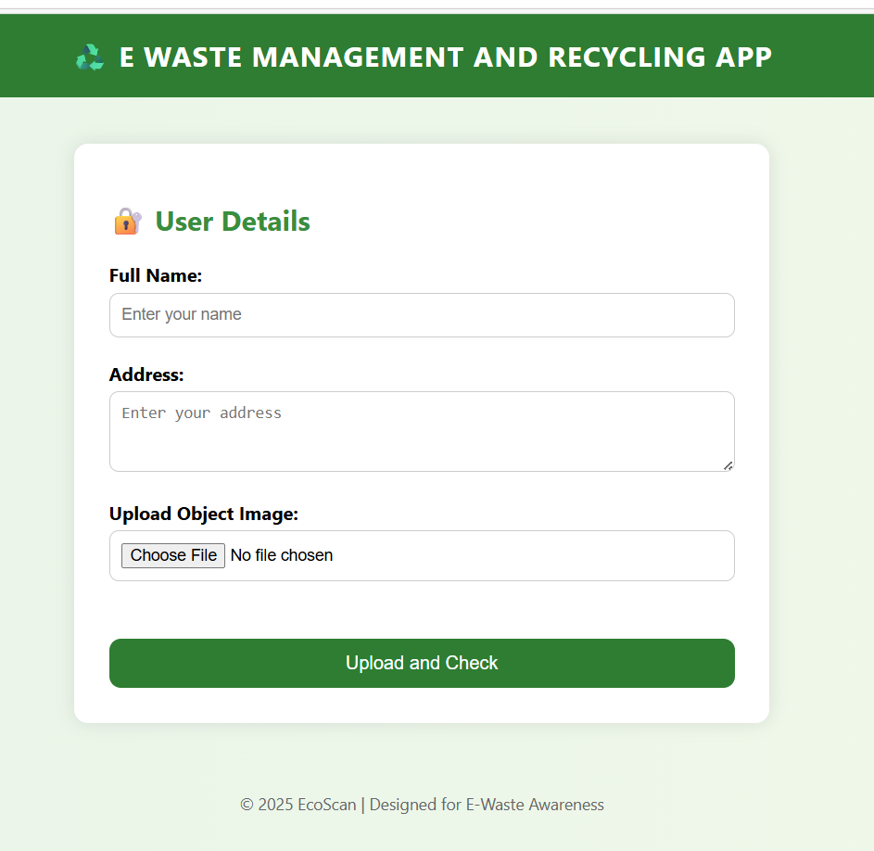
Example Home / Dashboard:

Slide 15
Dataset Description
Attribute | Details
Name : | E-Waste Images Dataset
Size : | 5,000+ images
Classes : | 10 categories: Battery, Keyboard, Microwave, Mobile, Mouse, PCB, Player, Printer, Television, Washing Machine
Format : | JPEG/PNG images, 224x224 pixels, RGB
Label : | Multi-class (10 classes)
Label Distribution : | Balanced (approximately 500 images per class in each of train, val, test)
Structure : | Train / Validation / Test folders with 10 subfolders for each class
Source : | Combined from Kaggle, Google Open Images, and manually collected data

Slide 16
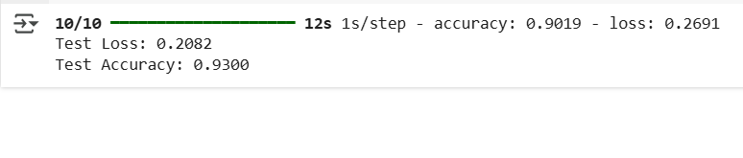
Model Evaluation Results
10/10 means the test was done on 10 batches of data.
12s 1s/step means the whole test took 12 seconds, about 1 second for each batch.
accuracy: 0.9019 means the model got about 90.19% of predictions correct during training or validation.
loss: 0.2691 is a measure of how wrong the model’s predictions were during training or validation—the lower, the better.
Test Loss: 0.2082 means the error on the test data is even lower, so the model is performing well.
Test Accuracy: 0.9300 means the model predicted correctly 93% of the time on new, unseen test data.

Slide 17

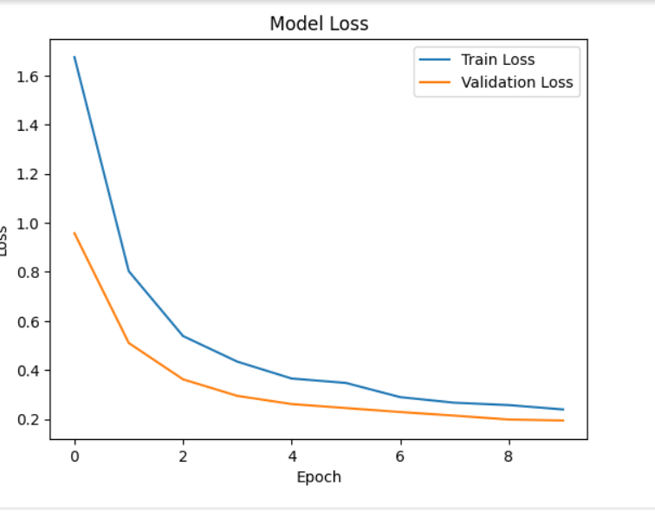
Model Accuracy Over Epochs and Model Loss Over Epochs

Slide 18
Challenges & Risks
Possible Challenges & Strategies to Overcome Them
1. User Awareness & Engagement
Challenge: Lack of awareness about e-waste disposal.
Strategy: Implement educational campaigns and in-app tutorials.
2. E-Waste Collection & Logistics
Challenge: Difficulty in collecting e-waste from different locations.
Strategy: Partner with local recycling centers and schedule pickups.
3. Data Management & Security
Challenge: Handling user data securely.
Strategy: Implement strong encryption and secure databases.
4. Government Regulations & Compliance
Challenge: Adhering to environmental laws.
Strategy: Work with legal experts to ensure compliance.

Slide 19
Conclusion:
We can achieve:
Functional E-Waste Management App – Users can easily locate recycling centers and schedule pickups.
Increased Awareness – Educates users on responsible e-waste disposal.
Efficient Waste Collection – Streamlined process for collecting and recycling e-waste.
Data-Driven Insights – Analytics on e-waste generation patterns for better planning.
Sustainable Impact – Contribution to environmental protection by reducing e-waste pollution.

Slide 20
References
[1] Baldé, C. P., Wang, F., Kuehr, R., & Huisman, J. (2017). The Global E-waste Monitor – Quantities, Flows, and Resources. United Nations University, International Telecommunication Union, & International Solid Waste Association.
[2] Kiddee, P., Naidu, R., & Wong, M. H. (2013). Electronic waste management approaches: An overview. Waste Management, 33(5), 1237-1250. https://doi.org/10.1016/j.wasman.2013.01.006
[3] Gupta, M., & Sahay, S. (2020). Design and development of a mobile application for e-waste collection and management. International Journal of Waste Resources, 10(2), 1-5.
[4] Lundgren, K. (2012). The global impact of e-waste: Addressing the challenge. International Labour Organization (ILO). [Online: https://www.ilo.org/global/publications/books/WCMS_196105/lang--en/index.htm]
[5] Garlapati, V. K. (2016). E-waste in India and developed countries: Management, recycling, business, and biotechnological initiatives. Renewable and Sustainable Energy Reviews, 54, 874-881. https://doi.org/10.1016/j.rser.2015.10.106
[6] Satyavani, K., & Babu, R. (2021). IoT-based smart e-waste management system for sustainable urban development. Smart Cities and Sustainable Development, 215-230.
[7] Mmereki, D., Li, B., Baldwin, A., & Hong, L. (2016). The generation, composition, collection, treatment, and disposal system of waste electrical and electronic equipment in Botswana. Waste Management, 51, 49-57.
[8] Borthakur, A., & Govind, M. (2017). Emerging trends in consumers’ E-waste disposal behaviour and awareness: A worldwide overview with special focus on India. Resources, Conservation and Recycling, 117, 102-113. https://doi.org/10.1016/j.resconrec.2016.11.011

Slide 21
Thank You

